Slide 1
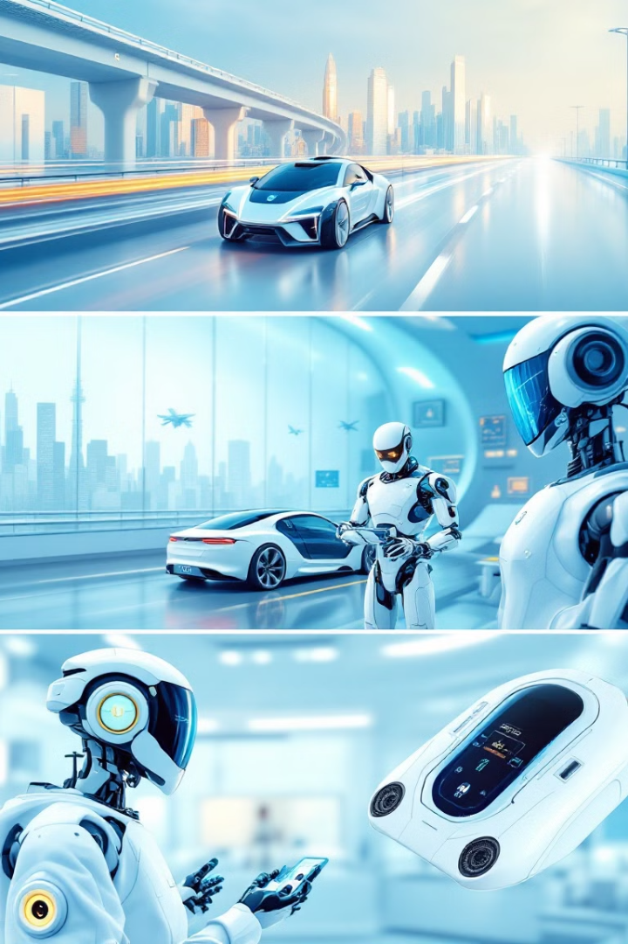
Chapter 1: Introduction to Artificial Intelligence
Welcome to the world of AI! This presentation will cover the basics of AI, including its definition, types, and key topics covered in an introductory AI course.

Slide 2

What is Artificial Intelligence?
Simulation
Learning
Simulating human intelligence in machines involves creating models and algorithms that mimic cognitive functions such as problem-solving, decision-making, and learning. This includes developing systems that can reason, understand natural language, and perceive their environment.
Acquiring knowledge through experience in AI involves enabling machines to automatically improve their performance on a specific task over time. This can be achieved through various methods such as supervised learning, unsupervised learning, and reinforcement learning, allowing AI systems to adapt and make more accurate predictions or decisions based on new data.

Slide 3




AI Course Overview: Key Topics
Search
Knowledge Representation
Handling Uncertainty
Optimization
Algorithms used to find information and solve problems, including graph search and heuristics.
Methods for dealing with incomplete or uncertain information, such as Bayesian networks and fuzzy logic.
Techniques for finding the best solution to a problem, such as linear programming and evolutionary algorithms.
Techniques for storing and representing knowledge in a way that AI systems can understand and use.

Slide 4
Narrow or Weak AI
Focused on performing a specific task with expert precision, Narrow AI excels within its defined parameters but lacks broader cognitive abilities. It operates efficiently within a limited scope, making it suitable for specialized applications where deep, but not wide, intelligence is required. Narrow AI does not possess consciousness, self-awareness, or the ability to perform tasks outside its pre-programmed functions.
Examples include AI-powered chess players like Deep Blue, advanced image recognition software used in medical diagnoses, and personalized recommendation systems that learn user preferences on platforms like Netflix and Amazon. These systems demonstrate exceptional proficiency in their respective fields by leveraging algorithms and vast amounts of data to achieve specific goals, but cannot generalize their knowledge or skills to other domains.

Slide 5
General or Strong AI
AI with the ability to understand, learn, and apply knowledge across a wide range of tasks, much like a human. Strong AI should be able to perform any intellectual task that a human being can.
Examples (Theoretical): Advanced AI assistants capable of handling diverse tasks, AI researchers able to make breakthroughs in various scientific fields.
Consider an AI assistant that can manage your schedule, understand complex requests, and even offer creative solutions to your problems. Or imagine an AI researcher capable of independently designing and conducting experiments, leading to significant advancements in multiple disciplines.
General AI aims to replicate human-level intelligence, exhibiting characteristics such as consciousness, sentience, and self-awareness. It would possess the capacity to not only solve problems but also to think creatively and adapt to unfamiliar situations.

Slide 6
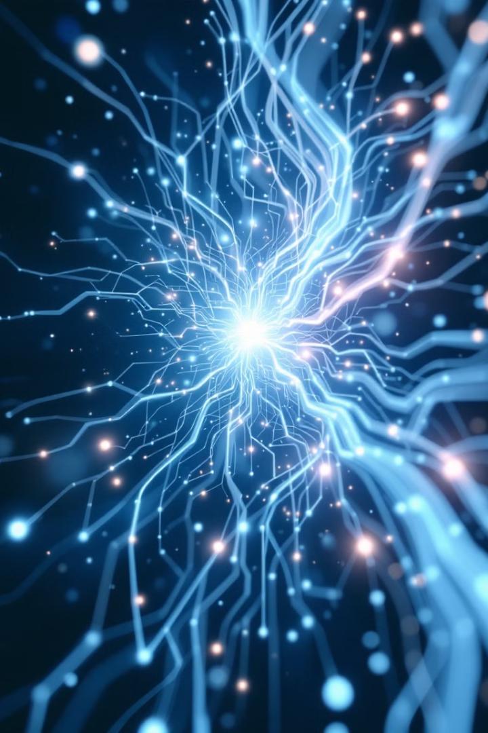
Artificial Superintelligence
An AI that surpasses human intelligence in all aspects, including creativity, problem-solving, and general wisdom. ASI is purely theoretical at this point and is a popular topic in science fiction.

Slide 7





AI Course Overview: Key Topics
Foundations of AI
Machine Learning
Deep Learning
Natural Language Processing (NLP)
History, philosophy, and ethical considerations.
Supervised, unsupervised, and reinforcement learning.
Neural networks, convolutional networks, and recurrent networks.
Text analysis, sentiment analysis, and machine translation.
Computer Vision
AI Ethics & Society
Image recognition, object detection, and video analysis.
Bias, fairness, and the future of AI.

Slide 8

Conclusion
AI is a transformative technology with immense potential. This course will provide you with a solid foundation in AI principles and techniques. Get ready to explore the exciting world of Artificial Intelligence! Q&A

